Slide 1
Infinite Cloud Storage via Abuse of Flickr
Harrison Zhao
David Katz
Alejandro Acosta

Slide 2
How?
Flickr supports the Portable Networks Graphics (PNG) format
Uses lossless compression
Encoding a file to an image byte by byte allows perfect reconstruction
Each Flickr account includes 1 TB of free storage
Each API key allows 3600 queries per hour

Slide 3

Sample File (Hello.docx, 294 KB)

Slide 4
Security and Scalability
Flickr supports uploading images for only personal visibility
Each user can attach as many Flickr accounts to their ICS account as they want
Each user uses their own keys to bypass API limits
All file I/O performed client side
Server manages database and signs requests

Slide 5
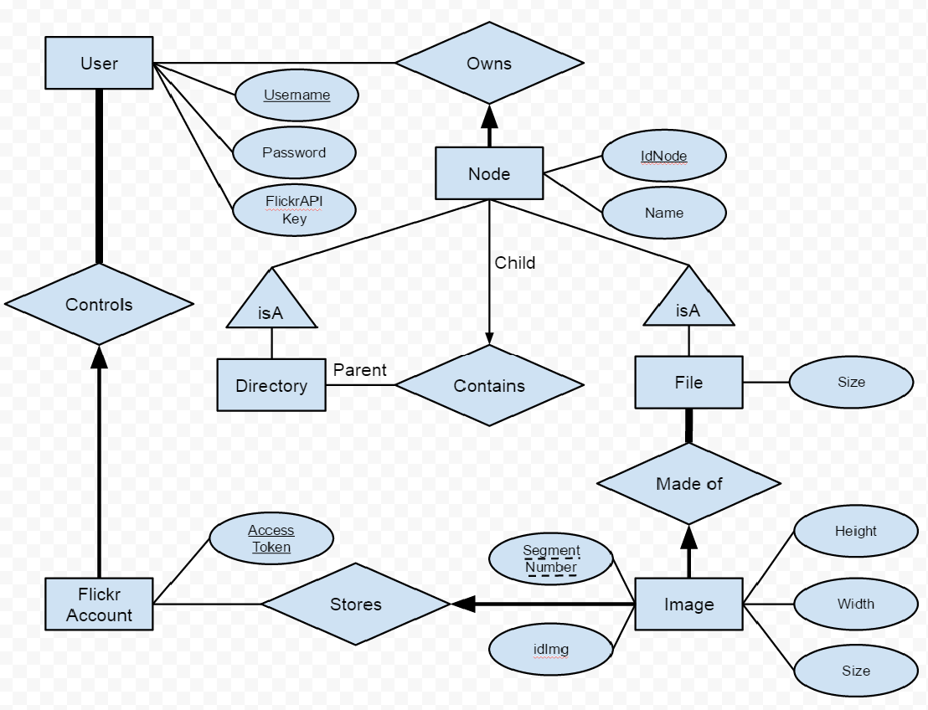

Slide 6
Try it Out!
infcs.cloudapp.net
Make an account (Use our keys if you are lazy)
Key: ec552e65e51f5ba1192ca326805d4bae
Secret: 55cb97c71a57b41b
Attach at least one Flickr (Yahoo) account by clicking top right corner from file system page.

